Slide 1


Internship
Project Presentation
Presented by
Koustab Ghosh | Debajyoti Sardar | Rahul Mondal
1

Slide 2



Company Name
About the Company
Global Secora Technology
Global Secora is a cybersecurity and technology company that provides advanced security solutions, professional training, and consulting services. The company specializes in Security Operations Center (SOC) services, SIEM, SOAR, Digital Forensics, Incident Response (DFIR), Threat Hunting, Vulnerability Assessment & Penetration Testing (VAPT), Cloud Security, and Red Teaming. Through industry-oriented training and real-world projects, Global Secora helps students and professionals develop practical skills in cybersecurity and emerging technologies.
CEO
Souvik Biswas
Internship Trainer
Riya Bera
https://www.globalsecora.com/.
2

Slide 3
Project Workflow
Project vision
01.
Dataset Collection
02.
Data Cleaning & Preprocessing
The objective of this project was to segment customers into meaningful groups based on their demographic and purchasing behavior using the K-Means Clustering algorithm. The project involved data preprocessing, exploratory data analysis (EDA), feature scaling, model building, and business interpretation to help organizations design targeted marketing strategies.
03.
Exploratory Data Analysis (EDA)
04.
Feature Scaling using StandardScaler
05.
Finding Optimal Clusters
06.
K-Means Clustering
07.
Customer Segment Analysis
08.
Business Recommendations
3

Slide 4
Tools, Technologies & Methodology Used
Programming Language
Python
Development Environment
Methodology
Jupyter Notebook
  Data Collection
  Data Cleaning
  Exploratory Data Analysis
  Feature Engineering
  Feature Scaling
  Elbow Method
  Model Training
  Cluster Visualization
  Business Insight Generation
Libraries Used
  Pandas
  NumPy
  Matplotlib
  Seaborn
  Scikit-learn
Machine Learning Algorithm
K-Means Clustering
(Unsupervised Learning)
4

Slide 5
  Customer Segmentation Results
The customer data was successfully divided into 4 meaningful customer segments using the K-Means Clustering algorithm.
IDENTIFIED CUSTOMER GROUPS
Premium Customers
Budget Customers
High Spenders
New Customers
  High income
  High spending
  Long-term customers
  Low income
  Low spending
  Moderate income
  Very high spending
  Short membership duration
  Moderate spending
5

Slide 6
Skills Acquired
  Problem Solving
  Critical Thinking
  Team Collaboration
  Documentation
  Data Interpretation
  Business Decision Making
6

Slide 7
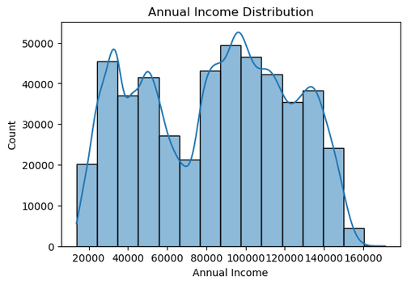
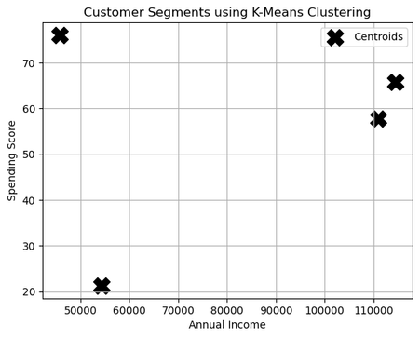
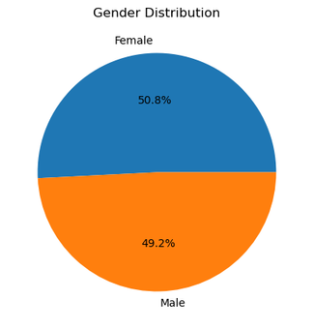
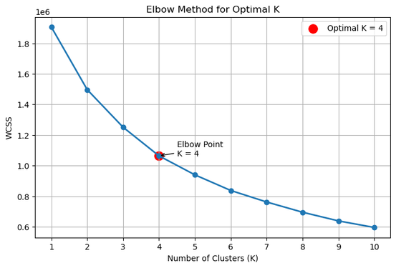
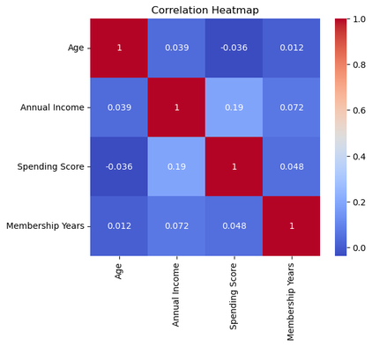
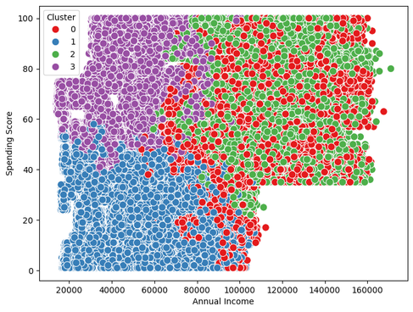
01.
04.
02.
05.
  Key Data Insights
03.
06.
7

Slide 8
Conclusion& Future Scope
Conclusion
Future Scope
This project successfully demonstrated the use of K-Means Clustering for customer segmentation. By analyzing customer demographics and purchasing behavior, four distinct customer groups were identified. These insights can help businesses implement personalized marketing strategies, improve customer satisfaction, increase customer retention, and make data-driven decisions.
  Apply advanced clustering algorithms (DBSCAN, Hierarchical Clustering)
  Use real-time customer data
  Integrate Deep Learning techniques
  Build an interactive business dashboard using Power BI or Tableau
  Deploy the model as a web application
8

Slide 9

THANK YOU
B.TECH CSE (DATA SCIENCE)
KOUSTAB GHOSH | TNU2024021100001
DEBAJYOTI SARDAR | TNU2024021100005
RAHUL MONDAL | TNU2024021100016
The Neotia University
9

